Slide 1
ACA
Hands Down Better

Slide 2
ACA
Who We Are
The American Chiropractic Association (ACA) is leading a modern movement of chiropractic care based on higher standards and a focus on patient outcomes.

Slide 3
ACA
What We Do
We model excellence in patient-centered, evidence-based care.
We serve our patients in the interest of public health.
We participate in the healthcare community through collaboration and integration.
We strive for excellence both personally and professionally.

Slide 4
ACA
Our Mission and Values Resonate
Over 10,000 subscribers and 2,000 discussions in online community, MyACA
Specialized communities for students, new grads, committees, and states

Slide 5
ACA
Patient Centered
Most importantly, our work focuses on what is best for the people we serve…
OUR PATIENTS

Slide 6
ADVOCACY
S. 4042 H.R. 2654
The Chiropractic Medicare
Coverage Modernization Act

Slide 7
Access for Patients
ACA seeks Medicare parity for Doctors of Chiropractic so they may practice to the full extent of their licensure. This is ACA’s top legislative priority.
Access to chiropractic is in the best interest of patients and a bipartisan effort: Medicare serves more than 55 million Americans.

Slide 8
S. 4042/H.R. 2654 Needs You!
The Chiropractic Medicare Coverage Modernization Act is bipartisan legislation which will provide patient access to all Medicare-covered benefits allowable under a chiropractor’s state licensure.

Slide 9
Take Action
Contact Your Member of Congress
Urge your Senator and Representative to co-sponsor S. 4042/H.R. 2654.
Thank them for their support of Medicare patients.
Join your profession in speaking to Congress in one, clear voice at acatoday.org/TakeAction

Slide 10
Take Action
Contact Your Member of Congress
Urge your representatives to co-sponsor.
Thank them for their support of Medicare patients.

Slide 11
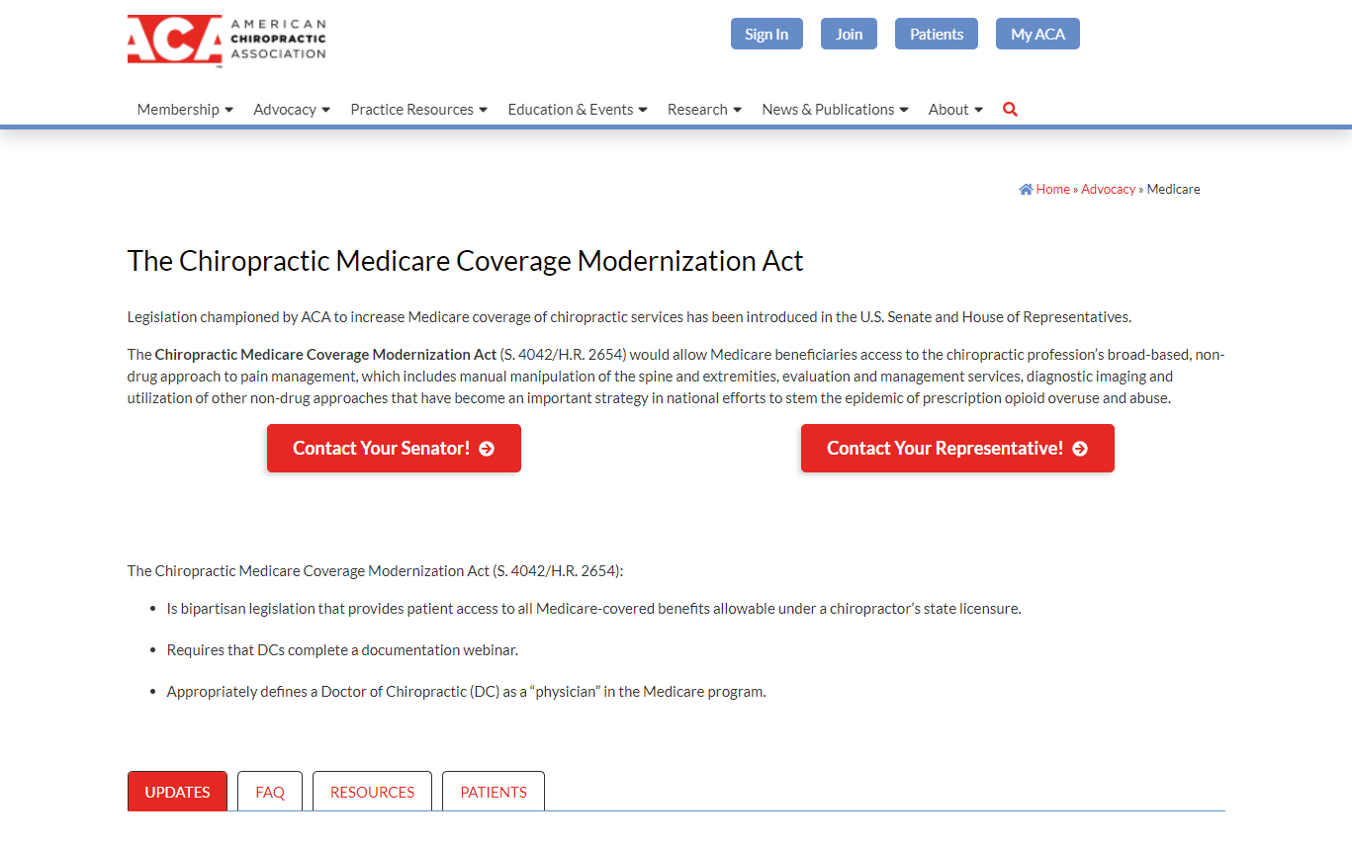
acatoday.org/Medicare
Contact Congress directly
Up to the minute info
Detailed FAQ
Resources for you and your patients

Slide 12
Join ACA
The Voice of Chiropractic
Promote Your Practice
Connect with other professionals at MyACA
Earn CE on your schedule at Learn ACA
Access resources for your practice and patients
Take advantage of member-only savings

Slide 13
GET ON BOARD
Join ACA at acatoday.org
Dive into discussion at MyACA
Support Medicare Patient Access at HR2645.org

